Slide 1
Lab ML Ranking Assignment
Irune Monreal Iraceburu
Sergio Marín Sánchez
Ander Ros Ollo

Slide 2
Table of contents
2
4
1
3
Pointwise
Bayesian Ridge Regression
Implement
model
MLR approach
Building the Training Set
Extend dataset
Cosine similarity with TF-IDF vectorization
Predicted Similarity Scores for New Documents

Slide 3
Pointwise MLR approach
f(query, document) relevance score
Order results by relevance score

Slide 4
Building the Training Set
Tf-Idf Vectorizer
Cosine similarity
]]
Extend dataset

Slide 5
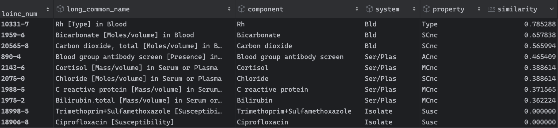
Building the Training Set
Dataset example with the similarity ranking for the query “glucose in blood”

Slide 6
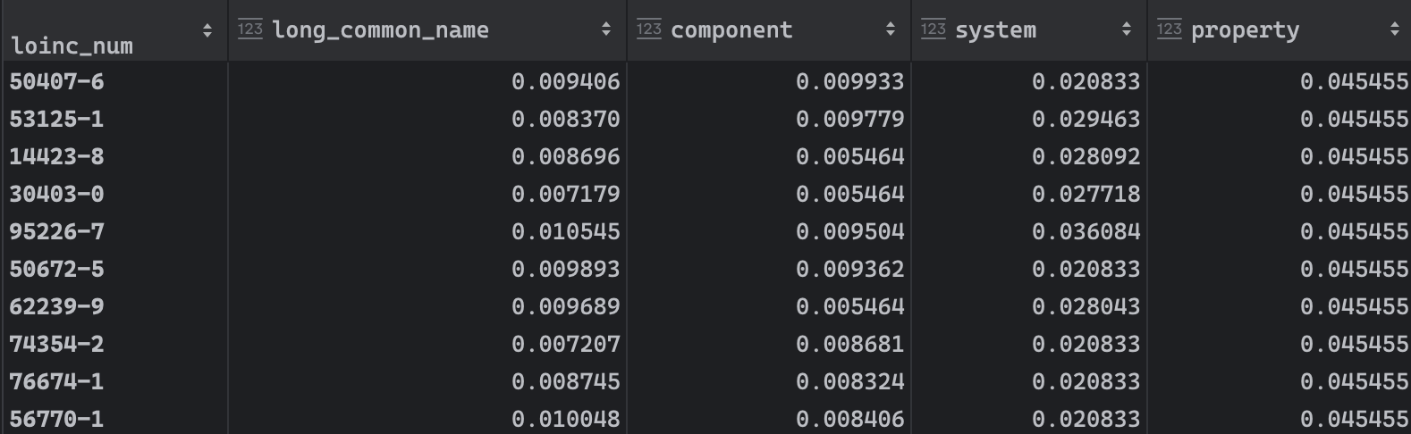
Encode the dataset for the training phase
Tf-Idf Vectorizer →
sum(tfidf_array) / len(tfidf_array)

Slide 7
Implement model
Example Results for
"Glucose in Blood"
Model Error: 0.21
Bayesian Ridge
loinc_num | y_test | y_pred
49926-9 | 0.47 | 0.59
15076-3 | 0.62 | 0.77
74774-1 | 0.58 | 0.36

Slide 8
Extend dataset (from LOINC )
loinc_num | long_common_name | component | system | property | similarity_glucose_in_blood | similarity_bilirubin_in_plasma | similarity_White_blood_cells_count
12345-6 | Glucose in Blood | Glucose | Blood | Mass | 0.63 | -0.17 | 0.20
12346-7 | Bilirubin in Plasma | Bilirubin | Plasma | Mass | 0.63 | -0.17 | 0.05
12347-8 | White Blood Cells Count | Blood Cells | Blood | Count | 0.64 | -0.16 | 0.26

Slide 9
THANK YOU!

